Slide 1
A NOVEL FACE MASK DETECTION MODEL FOR THE COVID-19 VISION TEMPLATE
D.NAGARAJENDRA
20N71A0518
4TH YEAR B.TECH CSE-A

Slide 2
Overview
Stakeholder and User Descriptions
Product Overview
Product Features
Constraints

Slide 3
Stakeholder & User Descriptions
Public health authorities: The model can help public health authorities monitor and enforce the use of face masks in public places, such as airports, hospitals, schools, and shopping malls. The model can help prevent the spread of infectious diseases, such as COVID-19, by identifying individuals who are not wearing masks or wearing them improperly.
Security agencies: The model can be used for security purposes, such as identifying individuals in restricted areas or detecting suspicious behavior. The model can help improve the safety and security of public and private spaces.

Slide 4
Stakeholder & User Descriptions
Automation industry: The model can be integrated into automated systems, such as robots, drones, or cameras, to perform face mask detection tasks without human intervention. The model can help reduce the workload and risks associated with manual inspections.
Research community: The model can be used for research purposes, such as studying the effectiveness of face masks in preventing the spread of infectious diseases or evaluating the performance of different machine learning algorithms for face mask detection. The model can help advance the scientific knowledge and understanding of face mask detection.

Slide 5
Stakeholder & User Descriptions
General public: The model can be used by the general public to check if they are wearing face masks properly and to avoid potential health risks.
Healthcare workers: The model can be used by healthcare workers to monitor the face mask wearing condition of patients and visitors in hospitals and clinics.
Security personnel: The model can be used by security personnel to detect individuals who are not wearing face masks in restricted areas or events.
Automation engineers: The model can be used by automation engineers to develop and deploy face mask detection systems in various industries and applications.

Slide 6
Stakeholder Summary
Name | Represents | Role | Key Needs
Public Health Authority | Hospitals, Schools, Airports, Etc. | Monitoring and Enforcing | Monitor and enforce the use of face masks in public places.
Security Agencies | Security Agencies | Identifying | Security purposes like identifying individuals without face masks in restricted areas
Automation Industry | Robots, Drones, Cameras, Etc. | Detection | Integrating into automated systems for hassle-free face mask detection
Research Community | Research Labs | Research | Studying the effectiveness of face masks in preventing spread of infectious diseases

Slide 7
User Summary
Name | Description | Key Needs
General Public | To avoid health risks | To check if they are wearing face masks properly and avoid health risks.
Healthcare Workers | Face mask wearing conditions | Monitor the face mask wearing condition of patients and visitors.
Security Personnel | Detect people | To detect people who are not wearing face masks in restricted areas or events.
Automation Engineers | Development and Deployment | To develop and deploy face mask detection systems in various industries and applications.

Slide 8
Product Overview
Perspective
Summary of capabilities
Assumptions and dependencies

Slide 9
Perspective
This project aims to use deep learning and computer vision to detect whether a person is wearing a face mask or not. This can be useful for preventing the spread of COVID-19 and enforcing public health measures. The project consists of two main steps:
Feature extraction: Using ResNet50, a deep convolutional neural network, to extract features from face images.
Classification: Using classical machine learning algorithms, such as SVM, decision trees, and ensemble, to classify the extracted features into masked or unmasked categories.

Slide 10
Summary of Capabilities
Hybrid model: The model combines deep transfer learning and classical machine learning algorithms to detect face masks in images.
Feature extraction: The model uses ResNet-50, a deep neural network, to extract features from face images.
Classification: The model uses decision trees, SVM, or ensemble algorithms to classify the face images into masked or unmasked categories.
Performance evaluation: The model is evaluated on three datasets of real and simulated masked faces, and achieves high accuracy and performance metrics.

Slide 11
Assumptions and Dependencies
Assumptions:
The face mask detection is a binary classification problem. The model only needs to distinguish between two classes: masked and unmasked faces. It does not need to recognize the identity, emotion, or other attributes of the faces.
The face mask detection is robust to different types of masks and poses. The model can handle various kinds of masks, such as surgical, cloth, N95, etc., and different ways of wearing them, such as covering the nose and mouth, or only the mouth. The model can also deal with different face orientations, such as frontal, profile, or tilted.

Slide 12
Assumptions and Dependencies
Dependencies:
The face mask detection relies on the quality and quantity of the datasets. The model needs sufficient and diverse data to train and test its performance. The datasets should include realistic images of masked and unmasked faces in different scenes and environments. The datasets should also be balanced and representative of the target population.
The face mask detection depends on the performance of the feature extraction and the classification components. The model uses Resnet50 as the feature extractor and three classical machine learning methods as the classifiers. The feature extractor should be able to capture the relevant features of the faces, such as the shape, color, texture, etc. The classifiers should be able to learn from the features and make accurate predictions. The model should also be able to fine-tune the parameters and optimize the hyperparameters of the components.

Slide 13
Product Features
Feature | User or Stakeholder Need Met
Identifies the people with or without face masks in real time. | It helps the user to avoid health risks.
Sends alerts to the person or the officials if not wearing masks or wearing it incorrectly. | It alerts and encourages to wear face masks properly.
It gets installed with existing surveillance cameras. | It gets installed at cheaper cost and works efficiently.
It can be used at public places to identify people without face masks. | It creates a safe public places and decreases the spreading of infectious diseases

Slide 14
Constraints
Some of the constraints of this project are:
It requires a large and diverse dataset of masked and unmasked faces to train and test the models effectively.
It may not be robust to different types of masks, occlusions, image variations, and environmental conditions.
It may have a high computational cost and complexity due to the use of deep learning and transfer learning techniques.
It may not be able to recognize the identity or emotion of the masked faces accurately.

Slide 15
ARCHITECTURE PRESENTATION

Slide 16
Overview
Architecture goals
Use case view
Logical view
Process view
Deployment view
Implementation view

Slide 17
Architecture Goals
The architecture goals of this project are:
Designing a Hybrid Model that can accurately detect whether a person is wearing mask or not.
The ability to extract features face images using ResNet-50 and classifying them using one of the machine learning classifiers they are decision trees, support vector machine or ensemble.
The model should be able to perform well on different datasets of masked faces (real and simulated) and life with wild.
The model should be time and processing efficient while maintaining high accuracy and reliability.

Slide 18
Use Case View
The major use cases of Face Mask Detection using Deep Learning:
Public health: The model can be used to monitor and enforce the use of face masks in public places, such as airports, hospitals, schools, and shopping malls. The model can help prevent the spread of infectious diseases, such as COVID-19, by identifying individuals who are not wearing masks or wearing them improperly.
Security: The model can be used for security purposes, such as identifying individuals in restricted areas or detecting suspicious behavior. The model can help improve the safety and security of public and private spaces.

Slide 19
Use Case View
Automation: The model can be integrated into automated systems, such as robots, drones, or cameras, to perform face mask detection tasks without human intervention. The model can help reduce the workload and risks associated with manual inspections.
Research: The model can be used for research purposes, such as studying the effectiveness of face masks in preventing the spread of infectious diseases or evaluating the performance of different machine learning algorithms for face mask detection. The model can help advance the scientific knowledge and understanding of face mask detection.

Slide 20
Logical View
The Functional Parts of this project are:
Deep feature generation: The model uses pre-trained ResNet-50 as feature generators to extract features from an image.
Classification: The model uses support vector machine (SVM) as a classifier to classify masked and unmasked faces based on the extracted features.
Data collection: The model collects face mask usage images and labels them as either mask, no masked, or improper mask.
Data preprocessing: The model preprocesses the collected data by creating three cases: mask versus no mask versus improper mask, mask versus no mask + improper mask, and mask versus no mask.
Performance evaluation: The model evaluates the performance of the hybrid deep feature-based masked face classification model on different datasets of masked faces, including real and simulated masks, and masked faces of celebrities.

Slide 21
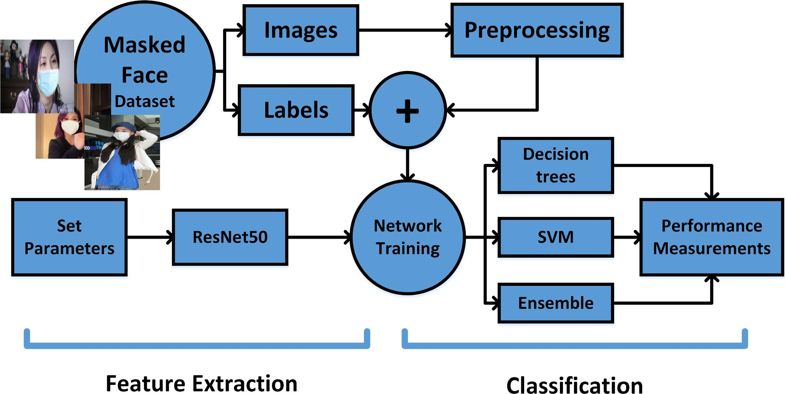
Process View

Slide 22
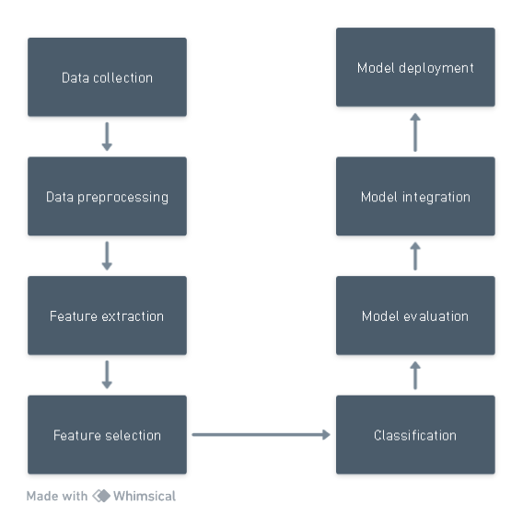
Deployment View

Slide 23
Implementation View
The experiments were conducted on a computer server equipped with an Intel Xeon processor (2 GHz) and 96 GB of RAM.
It also states that the MATLAB software package was used for the development and implementation of the different experimental trials

Slide 24
WORK BREAKDOWN STRUCTURE

Slide 25
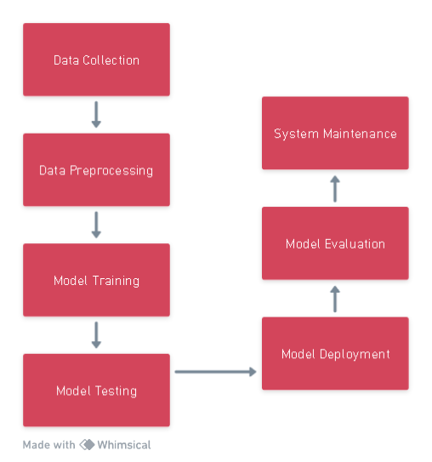
Work Break Down Structure

